Slide 1
A Comparative Study of Floyd-Warshall and Bellman-Ford Algorithms in Diverse Arbitrage Scenarios
Johnson Zhu
Notes:
My research is a comparative study of Floyd…

Slide 2
Overview
Part I
Historical Background & Definition of Arbitrage
Social Implication of Arbitrage
Part II
Currency Relationships in a Graph
Bellman-Ford & Floyd-Warshall Algorithm Analysis
Correctness & Time Complexity Proofs
Notes:
Graph: Facilitate Algorithm Execution

Slide 3
Overview
Part III
Experiment Methodology Introduction
Result Interpretation
Notes:
How we compare the efficiency of two algorithms

Slide 4
Part I

Slide 5
Historical Background & Definition of Arbitrage
Definition:
“The practice of taking advantage of price difference in two or more markets.”
Currency Arbitrage
“Achieve arbitrage by exploiting discrepancies between currency exchange rates.”
Historical Record of Arbitrage:
British merchant buying goods from China and India and resell it with higher price in Britain. (17th century)
Notes:
And one of the historical example of arbitrage is in the 17th century, when the british merchant

Slide 6
Social Implication of Arbitrage
Pareto & Free-Market Theory:
Arbitrage mitigate market overbalance.
Arbitrage stimulates financial transactions between market.
Arbitrage: Overall positive economic activity.
Notes:
However as the Pareto and free warket emerges people begin to view arbitrage‘s advantage

Slide 7
Focus of the Study
Recognizing the merit of arbitrage, the study discusses the comparative efficiency of two predominant arbitrage detection algorithms in various arbitrage scenarios, hoping to contribute to the industry.
Notes:
Finally the Focus of our study is to discuss the comparative efficiency of…

Slide 8
Part II

Slide 9
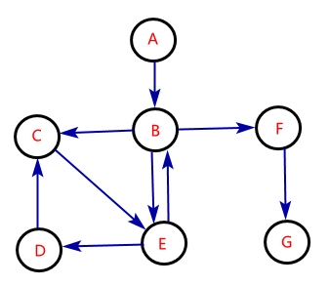
Currency Relationships in a Graph
Node (Vertex):
The currency
Weighted Edge (a, b):
Weight: The exchange rate at which currency A converts to currency B
Notes:
Before we delve into the algorithms, we have to know how the currency relationships could be transformed to a graph, which enables the execution of the algorithms. Edge: exchange rate relationship

Slide 10
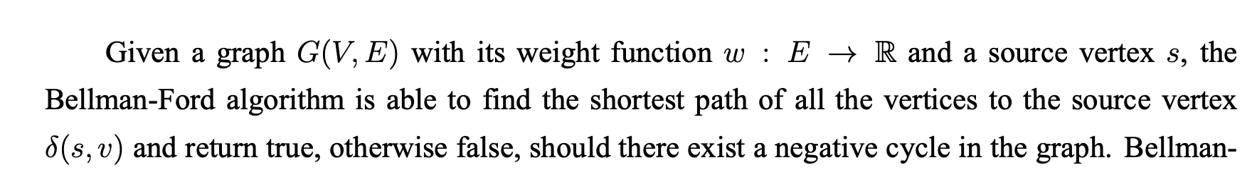
Bellman-Ford Algorithm
Functionality:
It finds the shortest path from vertex s to every other vertexes by repeatedly execute the Relax operation for |V-1| rounds.
Mechanism:
Notes:
Now with the graph notion established,we shall introduce the first algorithm

Slide 11
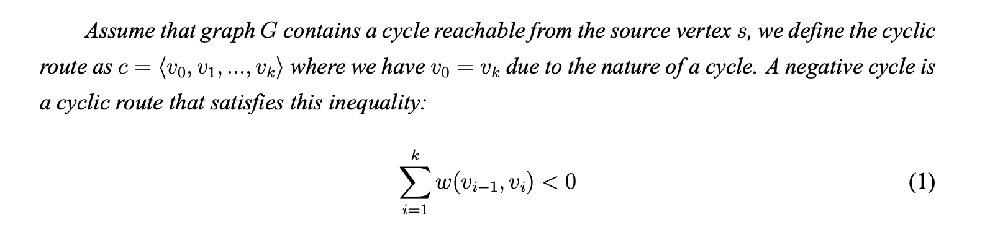
Correctness Proof of Negative Cycle Detection
Notes:
For the time sake, I‘m just gonna skip the entire correctness proof part.you can just see that we listed the definition of negative cycle. A negative cycle is a cycle that if you add all the weight value within, you get a negative value.

Slide 12
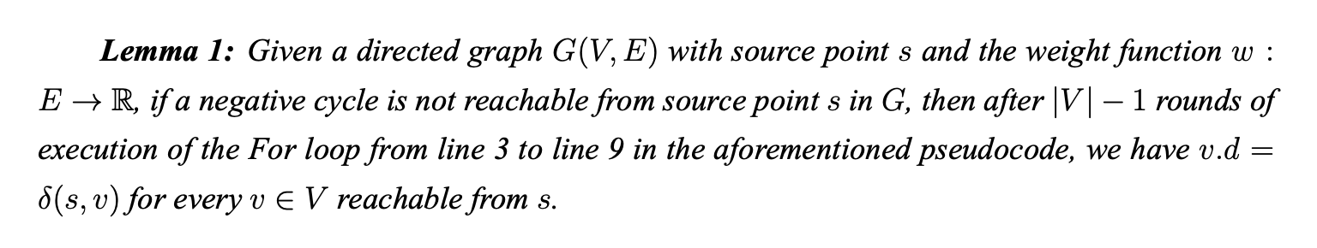
Proofs
Notes:
This is the specific proof of it, your welcomed to refer to my paper if you are curious.

Slide 13
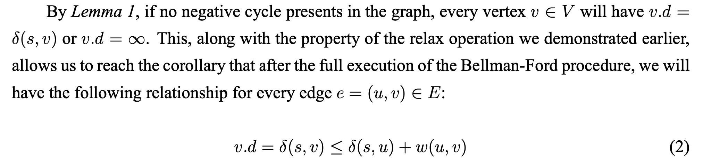
Relaxation Inequality
Notes:
By lemma 1, we acquire this inequality

Slide 14
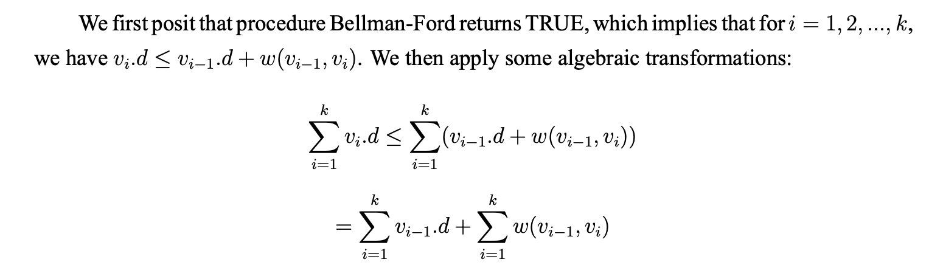
Hereby we proved Bellman-Fords correctness in detecting negative cycles.
Notes:
The result is basically that, by this algebraic transformation, we able to use proof by contradiction to show Bell-Ford’s correctness in detecting negative cycles.

Slide 15



Time Complexity
Single Execution
Arbitrage Detection (Execute on every node)
“Super Vertex” Optimization
Notes:
Here the take away is that the optimized complexity of Bellman-Ford Algorithm is quadratic.

Slide 16
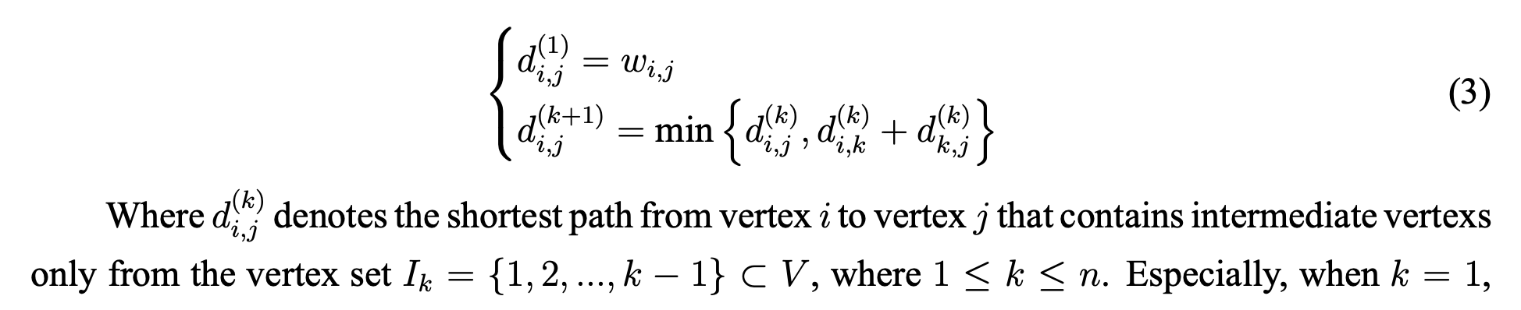
Floyd-Warshall Algorithm
Notes:
F-W uses a Dynamic Programming rationale.It claims this iterative relationship to find the shortest path, where d_(i,j)

Slide 17
Correctness Proof
Notes:
And once again I’m gonna skip the correctness proof part. You‘re welcomed to read through my paper if you are curious.

Slide 18
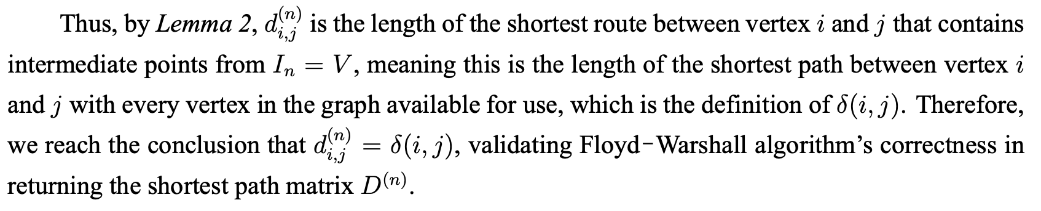
Correctness Proof

Slide 19
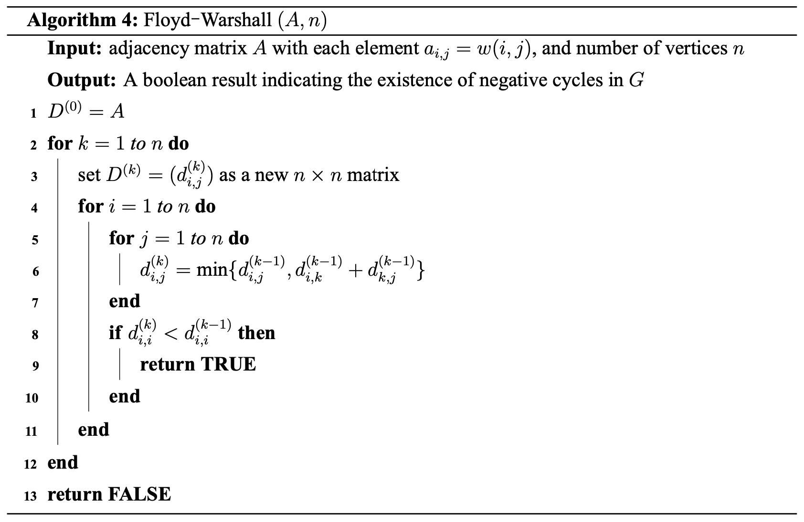

Time Complexity
Time Complexity:
Actual performance is unclear, in that the data structured used by F.W. algorithm has less time constant
Notes:
Three nested for loops, which yields a cubic time complexity, but since the data structure is faster, the actual performance is unclear. And need experimentation.

Slide 20
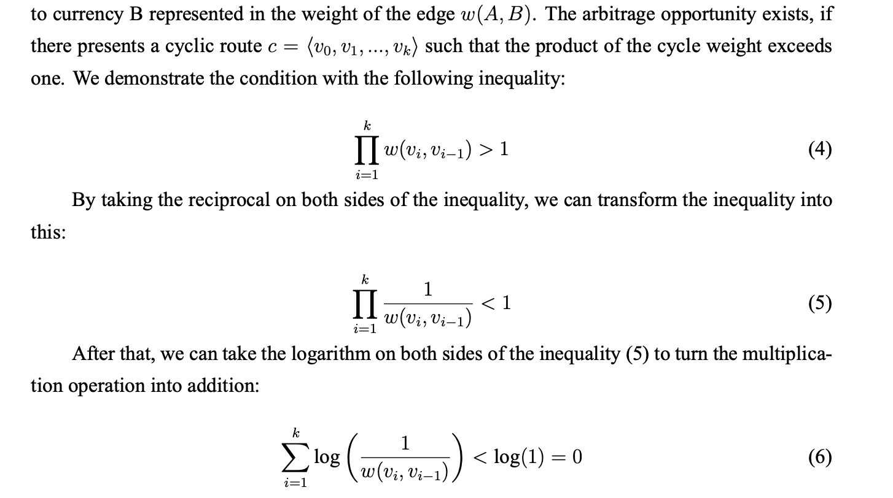
Reduction
Reduction from Negative Cycle Detection to Arbitrage Detection Problem
Notes:
Noticing I’ve been keep talking about negative cycle detection, and how does that connects to our focus: arbitrage problem.

Slide 21
Part III
Notes:
As mentioned earlier, ambiguity still exits for the comparative efficiency

Slide 22
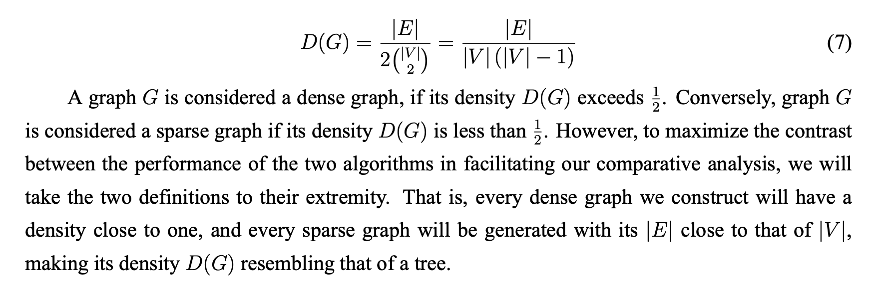
Density of Graphs
Notes:
To delineate the scenarios, we introduce the concept of density. You can view it as the ratio between the number of edges and nodes. We seperate scenarios as dense graphs and sparse graphs.A dense graph has a density exceeding one-half…, and for sparse graph. To maximize the contrast, we take their respective definition to extremity.

Slide 23
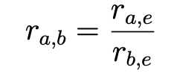
Methodology
Experiment data: Daily exchange rate of 150 currencies from 2021 to 2024 (150000+ entries)
Construct exchange rate graph of different number of nodes and density.
Execute both algorithms on graph with different nodes 30 times and record results with a error bar line graph.
Notes:
For the experiment data. All the currency exchante rates are normalized to euro, so we use this formula to denormalize it to arbitrary exchange rate.

Slide 24
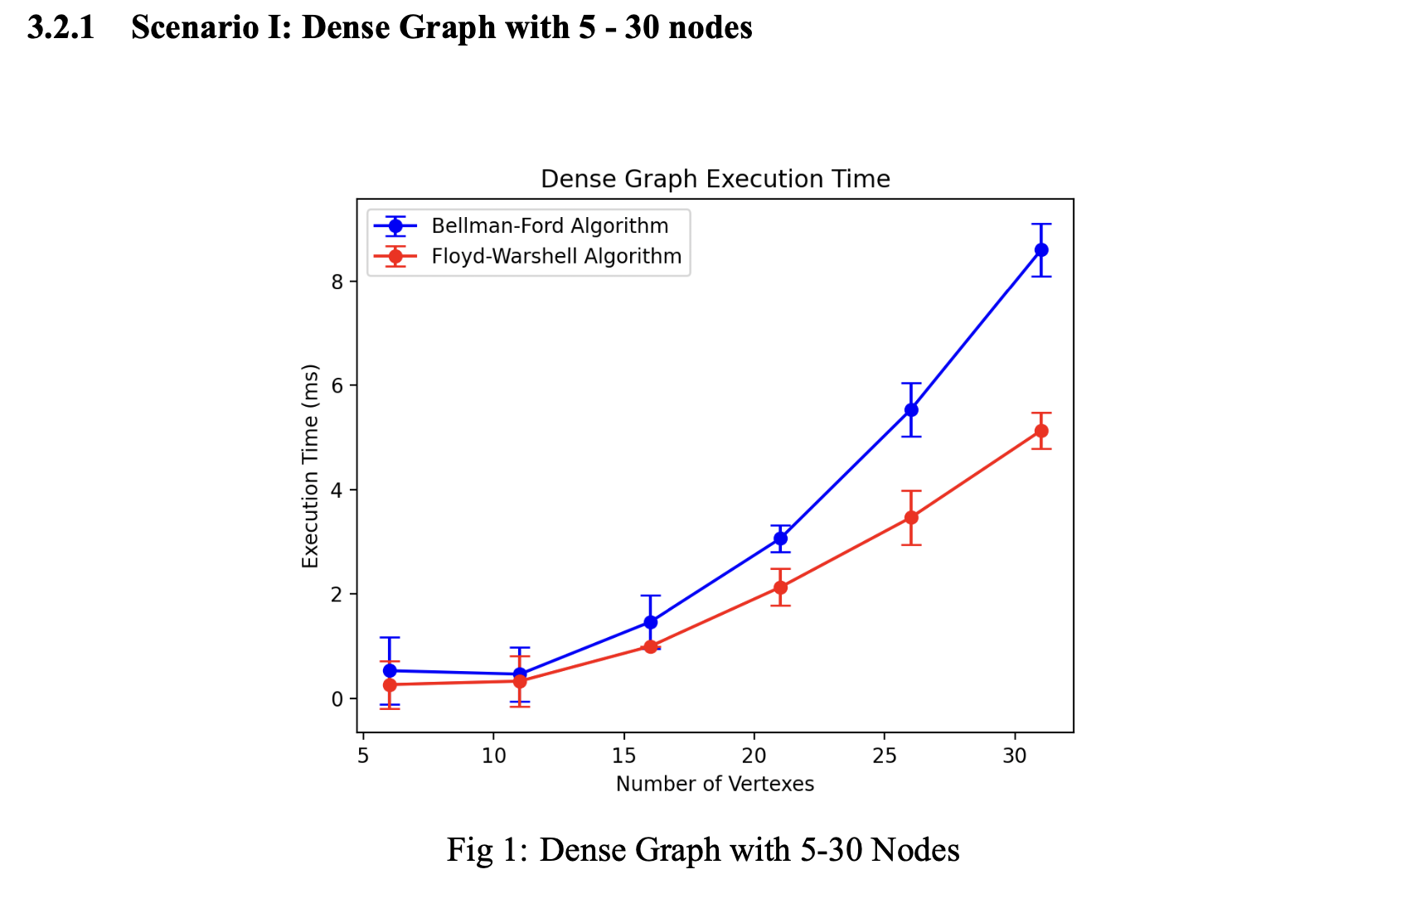
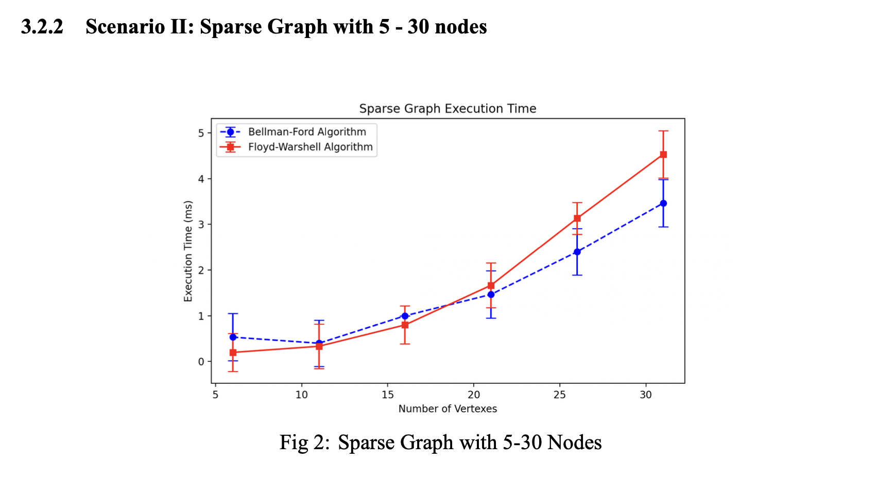
Scenarios (5-30 Nodes)
Notes:
The error bar represents the variant of the 30 executions. For the time sake, I’m just going to skip the graphic analysis part and directly show you the conclusion.(You could read my paper for the specifics.)

Slide 25
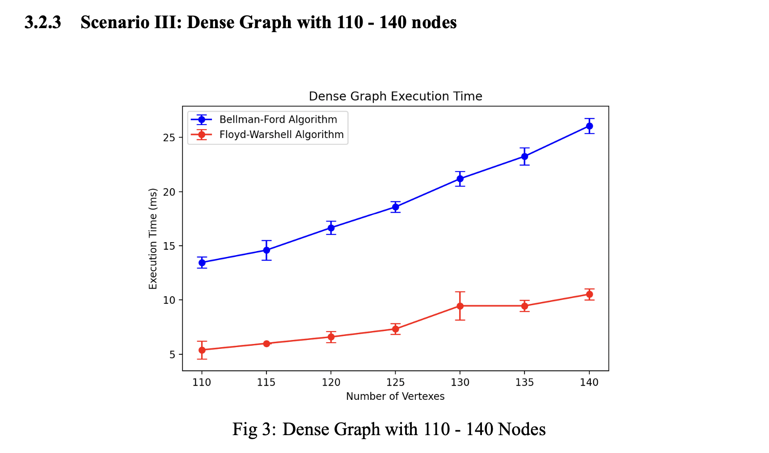
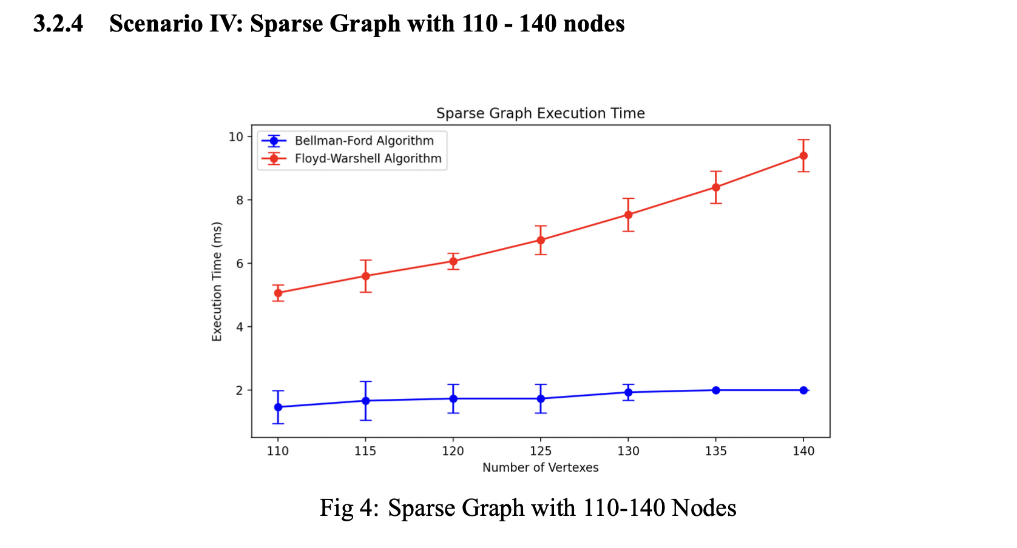
Scenarios (110-140 Nodes)
Notes:
For the time sake, I’m just going to skip the graphic analysis part and show you the conclusion.

Slide 26

Conclusion
Despite variability, Floyd-Warshall Algorithm seems to demonstrate superior efficiency in dense graph situations, whereas Bellman-Ford Algorithm is more efficient in sparse graph situations.
The performance difference between two algorithms enlarges as the number of nodes increase.
Notes:
In conclusion… Yet, insuffiency does present in the study

Slide 27
Thanks for listening

